Slide 1
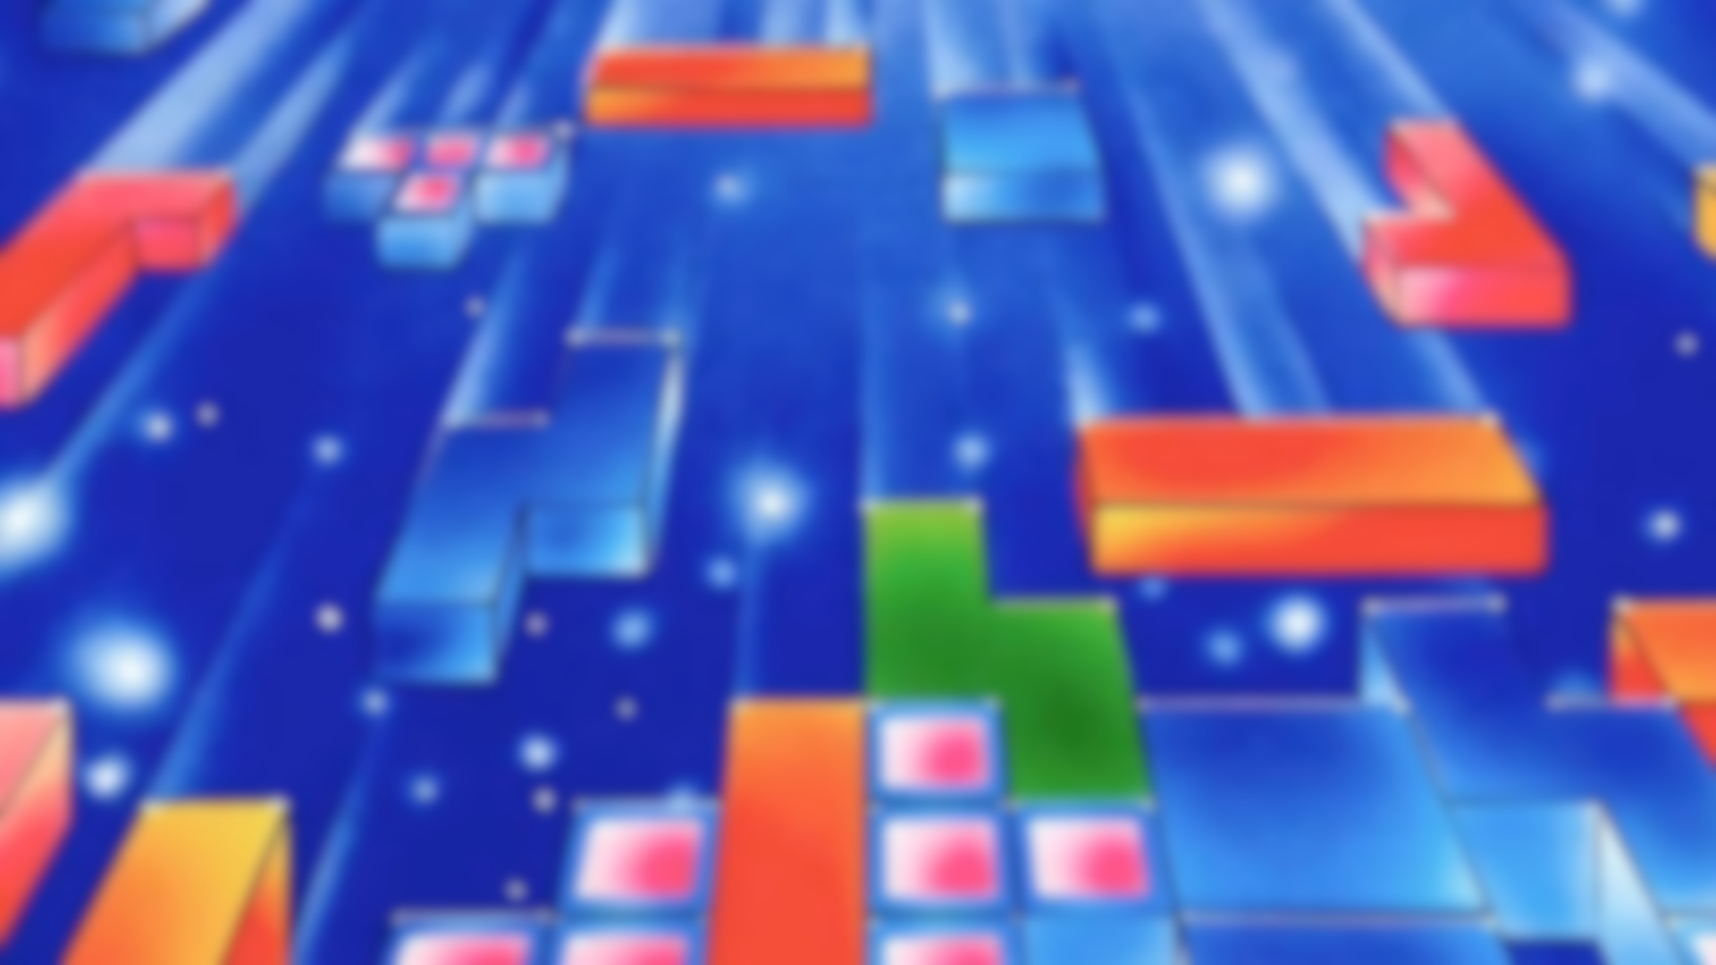
Reinforcement Learning Methods for Tetris NES
Noam Manaker Morag Itai Bear
Department of Computer Science, University of Haifa
Notes:
Hello world

Slide 2

Project Definition
Create an AI agent that plays the game of Tetris at a professional level
Explore and utilize different methods and techniques in Reinforcement Learning

Slide 3
Tetris NES
A classic yet timeless game that remains a cultural icon
Released in 1989 for the Nintendo Entertainment System (NES)
Notes:
Tetriminos are spawned from the sky and fall to the ground at increasing speeds
Must clear lines to survive and score points!
A classic yet timeless game that remains a cultural icon

Slide 4
Two Tetris Problems
Real-Time Gameplay
Per-Tetrimino Gameplay
An agent decides on an action (or no action) for each frame of the game
Hard and unsolved problem to this day
An agent decides only on the final position of a spawned tetrimino
Has been solved using a Particle Swarm Optimization method

Slide 5
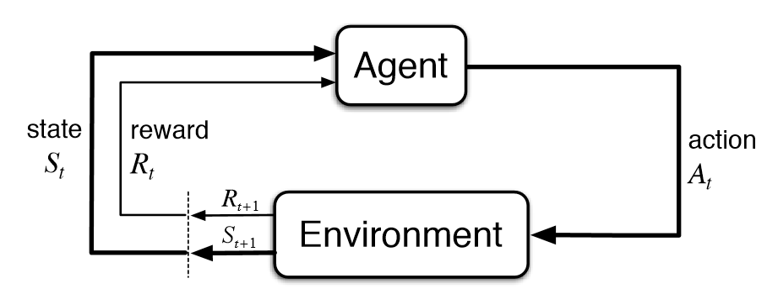
Reinforcement Learning
A type of machine learning paradigm
An agent learns to make decisions by interacting with the environment
Notes:
Reinforcement Learning (RL) is a type of machine learning paradigm where an agent learns to make decisions by interacting with an environment. The agent takes actions based on its current state and receives rewards or penalties, facilitating the learning of optimal behavior.
Specific methods used are shown on the poster

Slide 6
Results
We had no success with the Real-Time problem
As for the Per-Tetrimino problem, we reimplemented a former non-RL solution and expanded on the work by training an expert level agent using RL.
Notes:
As for the results, none of the methods we tried for the real-time problem were successful, however we did notice slight improvement when we tried the immitation learning approach

Slide 7
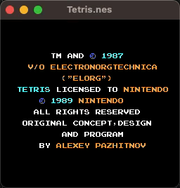
Demo of our trained RL agent playing Tetris with a per-tetrimino gameplay

Slide 8
